Slide 1
Working Capital Guideline
2006
ADVISORY

Slide 2
Working Capital Guideline
Contents
1. Our Approach to Working Capital 3
2. Working Capital Workstream 6
Cash Management 22
Monitoring 31
Appendices
Appendix I – Case Studies 43
Appendix II – Credentials 48

Slide 3
Our Approach to Working Capital
Working Capital: Where to start?
Our approach looks for opportunities to improve cash and Working Capital performance across all areas of the cash cycle
In the first few weeks of the project we will use a mixture of experience, benchmarking and analysis techniques to identify the businesses, processes and specific cash flows that have the greatest potential for enhancing cash generation and preservation
Management
of creditors
Management
of inventory
Management
of debtors
Purchase
Commit-
ments
Accounts
Payable
Raw
Materials
Work in
Progress
Finished
Goods
Accounts
Receivable
Stock turnover cycle
Collection period
Stock of inventory
Production
Stock of finished goods
Term of paym.
Money turnover cycle
Days inventory outstanding (DIO)
DPO
DSO
Money gap
Working capital cycle (days working capital)
Order
Cash
out
Start of
production
End of
production
Sales
Cash
in
DPO = Days payables outstanding; DSO = Days sales outstanding

Slide 4
Our Approach to Working Capital
Size of the prize
We will work with you to generate a full assessment of potential short and long term opportunities giving management the full picture to support their decisions about which projects to take forwards.
Strategic
Higher commercial risk
Structural
Increase use of less capital intensive production and logistics channels
Redesign supply chain
Margins improvement
Revise customer terms
Controls
Revise terms of trade
Identify non-core assets for sale
Capital expenditure
Payroll taxes
Staff incentives aligned with cash KPIs
Direct and Indirect Tax
Introduce cash KPIs to monitor inventory cycles
Accelerate invoice to collection time
Inventory corrections
Quick wins
Targeted better Working Capital Management in supplier companies
Revise credit controls
Stakeholder management and communication including cash performance
Overdue debtors collection
Negotiate creditor terms
Lower commercial risk
Payment controls
Control purchases
Cash forecasting
Property portfolio and redundant assets
Shorter term
Timescale
Longer term

Slide 5
Our Approach to Working Capital
Three fundamentals
The three fundamentals of our approach to embedding a Working Capital culture are:
  Creating a robust programme of operational and financial initiatives to drive sustainable improvements in Working Capital
  Establishing and refining an ongoing cycle of rolling cash forecasts
  Monitoring balances, flows and variances to focus in on areas for improvement
Robust forecasts
Strengthen cash controls
Identify opportunities
Embed initiatives in
reforecast
Communicate progress
to stakeholders
Forecasting
Optimise
Working
Capital
Monitoring
Investor KPIs
Monitoring of cash flows
and balances
Variance analysis
Prioritise initiatives
Prepare action plans
Set key milestones and
accountability
Implementation

Slide 6
Our Approach to Working Capital
Optimise Working Capital
Embed initiatives in
reforecast
Communicate progress
to stakeholders
Optimise
Working
Capital
Prioritise initiatives
Prepare action plans
Set key milestones and
accountability
Implementation

Slide 7
Working Capital Workstream
Our approach to Working Capital optimisation is divided into three separate stages
In a first step, the existing Working Capital structure is assessed and analysed
In the second stage, the main target is to make our client performing at least as good the peer group or the industry average
The concluding stage of our Working Capital Management approach aims at transforming our client into an Working Capital out performer
Stage 1
Assessment &
Analysis
Stage 2
Quick
Win
Stage 3
Out
Performing
Assessment & Analysis
In a first step, the existing Working Capital structure is assessed and analysed thoroughly by means of our in-depth knowledge of Working Capital Management
Key performance indicators appropriate to the business are determined and calculated for our client
Having assessed the status quo of our client’s Working Capital, industry and peer group averages are used to identify the areas of Working Capital where the client seriously underperforms in comparison with the industry/peer group
After the identification of the main problem areas, hands on solutions are developed by our professionals
Quick Win
In this starting stage of the implementation process of our Working Capital optimisation measures, the main target is to make our client performing at least as good the peer group or the industry average on a short term basis
We use the key performance indicators from stage 1 to monitor the progress of the implementation of measures
This stage is called “Quick Win” because the alignment to industry and peer group averages is a short term target, which is achieved in most cases in a relatively short space of time
Out Performing
The concluding stage of our Working Capital Management approach aims at transforming our client into an out performer regarding Working Capital
This long term target is achieved by the further optimisation of existing Working Capital structures as well as the implementation of our innovative solutions to Working Capital Management
Transforming our client into an out performer requires structural changes in the clients organisational processes and a stringent controlling of organisational processes

Slide 8
Working Capital Workstream
Optimising the Working Capital improves not only the liquidity position but also the key financial ratio ROCE
The cash conversion cycle determines the extent of capital employed and affects the balance sheet structure
Creditors
Purchase-to-Pay
EBIT
Working Capital
Inventory
Forecast-to-Fulfil
Liquidity
generation
(Cash Conversion Cycle)
ROCE
Capital
Employed
Debtors
Order-to-Cash¹
Assets
¹⁾ Sometimes: Customer-to-Cash

Slide 9
Working Capital Workstream
Key Performance Indicators are a vital part of an integrated Working Capital Management
There exist a number of different Key Performance Indicators monitoring the Working Capital
With our experience in Working Capital Management, we select the KPIs appropriate for the business and the specific needs of our client
Liquidity generation
(Cash Conversion Cycle)
Creditors
Inventory
Debtors
Purchase to Pay
Days Payables Outstanding (DPO)
Payables Balance
Best possible DPO
Percent early payment and percent payment to terms
Percent spend via corporate agreements/contracts
Spend by category
Spend by customer type/segment
Spend per functional FTE
Transactions per functional FTE
Transactions per supplier
Spend/Sales ratio
Forecast to Fulfil
Days Inventory Outstanding
Inventory turns
Delivery service levels
Service levels
Cash-to-cash cycle times
Lead times
Response times
Fill rates
Inventory management costs
Rate/productivity of value add
Returns rate and costs
Order to Cash
Days Sales Outstanding
Best possible DSO
Credit note - invoice ratio
Percent of invoices in dispute by category
Dispute resolution lag time
Aging and AR rollover rate
C2C functional headcount
Pareto analysis of customer base
Number of transactions by customer
Transaction type per FTE

Slide 10
Working Capital Workstream
The key financial ratios are DPO, DIO and DSO – adding up to the DWC
The key financial ratios in connection with Working Capital Management are Days Payables Outstanding (DPO), Days Inventory Outstanding (DIO) and Days Sales Outstanding (DSO)
Together, they add up to the Days Working Capital (DWC)
Working Capital =
Inventory
+ Accounts Receivable
-/- Accounts Payable
+ Balance of Instalments/
Prepayments
Creditors
Inventory
Debtors
DPO
(Days Payables Outstanding) =
(Payables /
(COGS¹ + OOE²))
x 365
DIO
(Days Inventory Outstanding) =
(Inventory / COGS¹) x 365
DSO
(Days Sales Outstanding) =
(Debtors / Sales) x 365
DWC
(Days Working Capital) =
DSO - DPO + DIO
¹⁾ COGS= Cost of Goods Sold
²⁾ OOE= Other Operating Expenses

Slide 11
Working Capital Workstream
The active management of the company‘s terms of payment improves the liquidity dramatically
Creditors
Inventory
Debtors
The cash conversion cycle is reduced as a result of an increase in average creditor days (DPO)
A further increase in liquidity is obtained by the conversion of commercial loan contracts into long term loan agreements
Target: increase in creditor days (DPO)
Creditor Management
The scope for the “procrastinating” of creditors has been exhausted by most companies
  Some suppliers threaten to suspend deliveries in case of a further excess of creditor days
  In some cases, prepayments are already being used
Suppliers are pressurised by credit insurers who disclaim their commitment in case of excess of the payment terms
50.0
60.0
55.0
+19%
46.8
39.5
35.0
7.2
Peer
Group
A
B
C
D
Average
Company/
Group
Target: conversion of commercial loan contracts into long term loan agreements
100
25
25
25
25
t1
t2
t3
t4
Creditor reduction target
Creditor Reduction Initiatives
The conversion of commercial loan contracts into long term loan agreements allocates the pressure of payment on a broader time frame
By increasing the creditor days of A and B Suppliers, additional liquidity is generated
E-Payment and Treasury Management Solutions can ensure valuable time when paying creditors
Instalments/prepayments as part of the agreed payment plan allow for increased financial flexibility

Slide 12
Working Capital Workstream
A stringent Inventory Management is essential for maintaining a strong liquidity position
Creditors
Inventory
Debtors
In the process of decreasing the inventory, all inventory is first analysed and then optimised and controlled by means of a stringent inventory management
Inventory Management
Inventory Audit
Improvement of
Organisational Processes
Monitoring
Cost reduction opportunities are derived from the comparison of key financial ratios and time series analysis
  ABC criteria
  Inventory rages
  Structure of inventory
Target figures are reviewed and being defined
Derivation of measures
Analysis of weaknesses of the supply chain
Process control / structure
Derivation and implementation of measures
  Short term: Clearance and restrictive purchase and production planning
  Long term: Basic process (manufacturing process, assortment structure, sales and production planning, logistics) and structural changes
Definition of key figures / ratios
Definition of threshold values
The controlling of the inventory cut back has to be ensured by means of loop control, which will be permanently implemented into the organisation after completion of the project
Monitoring of the planned decrease
Operating
Measures
Structural
Measures
Implementation
Controlling

Slide 13
Working Capital Workstream
By defining the appropriate safety stock for all individual products/ parts, unnecessary levels of inventory are avoided
Creditors
Inventory
Debtors
The safety stock is determined in dependence on the consumption value and the forecasting accuracy of a product/part
Safety stock
Avoidance of supply
bottleneck by
purchasing/
prefabrication
Avoidance of delivery
bottleneck with
respect to customers
Z-parts
Y-parts
C-parts
B-parts
X-parts
Forecasting
accuracy
A-parts
Consumption
value

Slide 14
Working Capital Workstream
The repurchasing time is a key figure in determining which minimum level of inventory should be held
Creditors
Inventory
Debtors
A detailed analysis of the repurchasing time on the level of individual parts is beneficial in determining the minimum level inventory held and therefore the possible reduction in inventory
Analysis of parameters – Repurchasing time
Range - actual
Repurchase time – min.
Repurchase time – max.
Type of
Inventory
N°
articles
Repurchase time
Volume
Inventory raw
Range
Months
(months)
(year, k€)
materials (k€)
(months)
1
2
3
4
5
6
7
8
Type A
10
0.5 - 1.3
400
154
3.7
Type B
69
1,150
700
3.5
Subtype B1
25
500
Subtype B2
9
0.4 - 2.1
200
Subtype B3
15
0.3 - 1.7
300
Subtype B4
20
0.3 - 1.7
150
Type C
37
215
114
6.7
Subtype C1
25
0.25 - 3
150
Subtype C2
12
1.3 - 2.5
65

Slide 15
Working Capital Workstream
Increasing the order frequency is a key component of an integrated inventory management
Creditors
Inventory
Debtors
Taking into account delivery time, significant cost reductions can be achieved by increasing the order frequency.
Target: Increasing order frequency
Inventory
Inventory - Actual
Inventory - Target
∅ Inventory
actual
Reduction in
inventory
∅ Inventory
target
Days
Actual State
Range of procurement warehouse approx. 3 - 4 months Materials management and purchasing are organisationally assigned to production Inventory responsibility lies with one purchasing agent Inventory monitoring is not carried out systematically Monthly forecast Advance deliveries are being accepted Performance of warehouse manager in charge is not being measured
Target State
Target range: 1 month - for Super A-parts 14-days are possible Materials management and purchasing separate division Materials requirements planner should be responsible for the inventory Target ranges have to be defined and controlled/ monitored regularly Bisection of average inventory by switching to a two week forecast Insist on exact (Just-in-Time) deliveries Performance of warehouse manager in charge measured by range of inventory

Slide 16
Working Capital Workstream
Having analysed the inventory, specific reduction initiatives are being designed and implemented
Creditors
Inventory
Debtors
The cash conversion cycle is reduced as a result of a reduction in average days inventory out-standing
Target: reduction in inventory days (DIO)
Financial analysis and benchmarking
31.0
-24%
  Comparison with competitors and valuation of potential inventory reduction on the basis of financial ratios
  (e.g. inventory days)
  Utilising different ratios according to inventory type
  (raw materials, unfinished goods, finished goods)
  Time scale analysis of inventory days ratios may serve as a cross-check
  Defining the minimum inventory scope by analysing the necessary replacement time
  Increasing order frequency to reduce inventories held
30.0
20.0
22.0
18.0
22.8
7.2
Peer
Group
A
B
C
D
Average
Company/Group
26
27
32
30
24
24
Year
2000
2001
2002
2003
2004
Min
Inventory reduction target
Inventory Reduction Initiatives
 |  | Impact on
action taken | raw materials | unfinished goods | finished goods
Clearance sale of manufactured goods
Reduction of inventory scope
Examination of orders with high value of goods
Defining responsibilities for inventory types
Just-in time deliveries
Improvement of inventory planning
low
middle
high

Slide 17
Working Capital Workstream
A well designed debtor management frees up cash by optimising the company’s debtor structure
Creditors
Inventory
Debtors
The reduction of total debtors is essential in maintaining liquidity
Debtor Management and Analysis
Structure of debtors | Terms and conditions of payment | Overdue debtors
Domestic/ export Countries Divisions Customers Age structure Sales responsibilities | What Terms/ Conditions? Who defines Terms/Conditions? What is the average Terms of Payment? How are Prepayments being handled? What Means of Payment do exist? | Are dunning letters being used? How often are customers being dunned? What happens after the pre-collection letter is sent out? Are claims enforced by legal action? In what way is the sales department involved? Cause analysis for overdue debtors Which are the largest debtors? How is the credit ranking determined?
  Objective of the reduction of debtors has to be the short term collection of overdue debtors and the lasting optimisation of the accounts receivable management
  Detailed analyses are a key success factor
    Analysis of debtor structure
    Analysis of the causes for overdue debtors
    Determination of the overdue debtors with the largest balances
  In the long term, the collection of debtors has to perform in compliance with the business model and the entire industry
  Experience shows that in most cases, debtors can be reduced by approximately 10-25%

Slide 18
Working Capital Workstream
Debtor management aims at reducing a company’s overdue debtors as well as reducing the overall debtor days
Creditors
Inventory
Debtors
Focus of debtor management are debtors as well as instalments/ prepayments
Measures aimed at the reduction of debtors for different industries have to be adjusted accordingly
Structure of company’s debtors
+13.5%
63.6
167.1
20.4
91.2
103.5
43.1
75.6
Focus of debtor management
31.6
55.3
59.6
91.5
48.2
Debtors
12/31/03
Debtors
12/31/04
Instalments/
Prepayments
Total
12/31/04
due
not due
Financial analysis and benchmarking
  The marketing and sales department needs to be made responsible for the collection of debtors and has to be supported by a professional debtor controlling
  The measurements in order to ensure the long term receipt of payments have to concentrate on the improvement of internal invoice processing and dunning processes
  The average amount of debtors can vary in-between industries – measures have to be adjusted accordingly:
    In case of large individual debtors, main focus has to lie the collection of overdue debtors
    In case of a large number of small individual debtors, the main focus should lie on the internal invoice processing and dunning processes
  Comparison with competitors and valuation of potential accounts receivables reduction on the basis of financial ratios (e.g. debtor days); time series analysis of debtor day ratios may serve as a cross-check
  Examination of recoverability of accounts receivables

Slide 19
Working Capital Workstream
A structured analysis of debtors by destination (domestic/export) helps defining initiatives aimed at reducing debtors
Creditors
Inventory
Debtors
Highest priority is given to the collection of overdue debtors with the largest balances
The causes for overdue debtors have to be analysed in order to be able to avoid the come about in the future
Debtors structure – analysis of overdue debtors by destination and customer
3%
10 Customers < T€ 100
60 Customers
Domestic
48%
10%
19 Customers T€ 100 - 200
46,7%
18%
23 Customers T€ 200 - 300
52%
16%
13 Customers T€ 300 - 400
Customer A
Customer B
Customer C
Customer D
Customer E
Customer F
Customer G
Customer H
60%
Overdue debtors
54,3%
53%
> T€ 400
40%
Debtors
Domestic
Debtors
Total
Debtors
Export
Overdue
Debtors
Export
Debtors structure – analysis of reasons for overdue debtors
external
23%
Payment problems customer
not due
overdue
18%
Inadequate debtor management
€ 65.4 m
43%
€ 87.6 m
57%
17%
Complaints due to technical
problems
Influenceable
debtors:
➔ Short term
generation of
liquidity
possible
internal
17%
Controversial endorsements
17%
Unfavourable terms
of payment
8%
Promise to pay at hand

Slide 20
Working Capital Workstream
Analysing the age structure of the company’s debtors as part of debtor management allows for custom solutions to be designed
Creditors
Inventory
Debtors
Debtors that are overdue for more than 120 days have to be addressed separately
Debtors structure – analysis of age structure
in % of
total
debtors
100%
53%
16%
6%
5%
4%
18%
4%
180.0
95.0
28.5
10.5
33.3
8.2
7.1
7.5
Date
Debtors
thereof due
and overdue
thereof
thereof
thereof
thereof
thereof
thereof in
(€ m)
overdue
overdue
overdue
overdue
overdue
legal
0-30 days
31-60 days
61-90 days
91-12 days
>120 days
action
07/2005
180.0
95.0
53%
28.5
10.5
8.2
7.1
33.3
7.5
06/2005
175.3
91.3
52%
27.4
10.0
7.9
6.8
32.0
7.2
05/2005
184.9
101.8
55%
30.5
11.2
8.8
7.6
35.6
8.0
04/2005
165.4
85.3
52%
25.6
9.4
7.3
6.4
29.9
6.7
03/2005
212.7
97.3
46%
29.2
10.7
8.4
7.3
34.1
7.7

Slide 21
Working Capital Workstream
Specific debtor optimisation initiatives are derived from a thorough analysis of the company’s debtor structure
Creditors
Inventory
Debtors
The cash conversion cycle is reduced as a result of a reduction in average debtor days (DSO)
Ratio analysis debtor days (DSO)
Financial analysis and benchmarking
  Comparison with competitors and valuation of potential accounts receivables reduction on the basis of financial ratios (e.g. debtor days)
  Time scale analysis of debtor day ratios may serve as a cross-check
  Examination of recoverability of accounts receivables
  Cause analysis for delinquencies
  Analysis of delinquencies
  (according to customers, business units, etc.)
54.1
-20%
53.9
52.1
44.3
35.8
43.2
10.7
30.1
Peer
Group
A
B
C
D
E
Average
Company/ Group
45
52
57
54
41
20%
25%
41
13%
15%
19%
13%
2000
2001
2002
2003
2004
Target
terms of payment (days)
Overdue accounts receivable
Debtor reduction target
Debtor Reduction Initiatives
  Focus should lie on the reduction of delinquencies
  The accounts receivable management should be improved and optimised
  Introduction of a professional accounts receivables controlling
  The dunning process will be intensified
  Co-operation with a factoring company
  Introduction of incentive scheme
  Definition of clear responsibilities

Slide 22
Our Approach to Working Capital
Forecasting
Forecasting
Robust forecasts
Strengthen cash controls
Identify opportunities

Slide 23
Cash Management
Realisation of cash generating opportunities requires focus on a cash flow culture
To realise opportunities to generate cash, it is important to have the relevant organisational skills and tactical ability in place
Benefits realised
Reduce net debt
Improved DCF-based valuation
Minimisation of new monies required
Enhanced visibility and reliability
Increased stakeholder confidence
Generate improved free cash flow
Robust cash forecasting, controlling and monitoring
Tactical skills
Cash forecasting
Receivables
Payables
Treasury management
Inventory management
Controlling
Working capital and cash flow culture
Organisational capability
Board level sponsorship
Communication and buy-in
Training and coaching
Contingency mindset
Reward structure

Slide 24
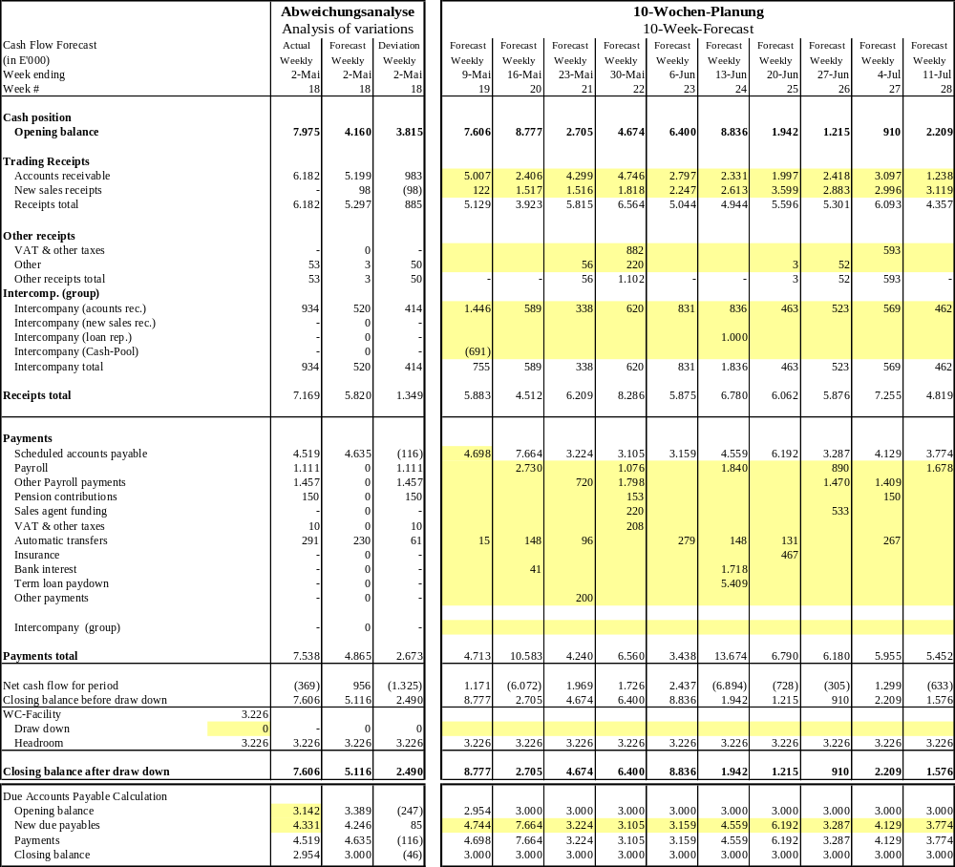
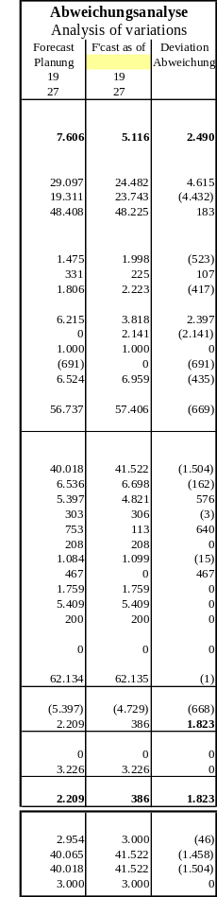
Cash Management
Illustrative cash flow forecast template
The cash flow forecast template seeks to meet the various user needs whilst not being onerous to the team preparing the data.
Production is assisted with standardised group instructions, coaching and the output supported by documented assumptions.
Cash in
Cash out
Headroom
Development of overdue liabilities
Actual
vs. forecast
last period
Short term liquidity forecast on a 10 week rolling forecast basis
Forecast last period vs. forecast current period

Slide 25
Cash Management
Steps to a robust cash forecast
The standardised forecast process is based on a detailed bottom-up methodology to improve the quality of the Group‘s cash management.
The process could be introduced in a relatively short space of time with refinements evolving as the forecasts are updated.
1
2
3
4
5
Financial status
New sales
& purchases
Group
items
Review &
challenge
Monitoring
The financial status is based on balance sheet items at the end of the relevant period
All items impacting cash are identified and the timing quantum of the cash impact is forecast
A bespoke report could be created to unwind the accounts receivable ledger by customer based on individual historical payment profiles
Existing accounts payables are unwound in accordance with known payment runs
New sales receipts are based on the estima-tions of the sales department and historic receipts profiles
Purchases are planned according to material categories (production plans) and suppliers‘ conditions as adjusted for existing inventory positions
Other purchases are based on historic levels and know commitments
Future capex is based on the capex budget and scheduled plant maintenance being challenged to only accept necessary items
The cash inflow from group accounts agreed to local management‘s cash flow forecast
Standardised analysis of available and trapped cash within the Group
Enhanced visibility of available cash reserves
All inputs and outputs reviewed and challenged by the senior management
Risk areas are identified and potential sensitivities estimated
Forecasting procedures are reviewed and improved where appropriate
Comparison of actual performance against forecast
Monthly re-forecasting
Forecasts form the basis for monitoring cash improvement initiatives

Slide 26
Cash Management
Weekly cash desk meeting to keep cash flow under control
Robust cash management requires clearly defined organisational procedures and responsibilities.
This includes implementation of regular cash team meetings combined with payment controls through senior management involvement.
Responsibility
Calendar week
Date
Monday
Tuesday
Wednesday
Thursday
Friday
Target Group
Liquidity status
Liquidity status
Liquidity status
Liquidity status
Liquidity Status
Creation of purchasing list and payment list
(incl. attached invoice copies higher 20 k€)
Payment run
Report of
Departments:
  Accounting Dep.
  Purchase Dep.
  Sales Dep.
  Finance /
  Controlling Dep.
Weekly paym. & rec. overview
Analysis of deviation
Cash-Desk-Meeting
  Review of status and liquidity plan
  Review of purchasing list
  Release of payments
  Other measures
Update on short term liquidity planning
Process control and verification
KPMG
Monitoring of short term cash flow planning and management
Shareholder
Short term cash flow planning

Slide 27
Cash Management
A variance analysis is conducted on a weekly basis
Our approach to cash management includes a detailed analysis of variations within the weekly cash flow
Feedback is given to the individuals in charge, thereby improving the forecasting accuracy week by week
PLAN
ACTUAL
Planned payments
based on detailed analysis
Comparison of planned and actual payments
conducted by KPMG
Row material order
Marketing
Actual material
Actual Marketing
Production
Administration
Actual production
Actual admin.
Personnel
etc.
Actual personnel
etc.
Verification of planned payments
conducted by KPMG
Monitoring of actual payments
conducted by KPMG
Cash Desk Meeting
Payment

Slide 28
Cash Management
Appendix: Template - cash report for week ending [ ]
Summary
  Current position
  Summarise the current headroom and the main differences from the previous forecasts
  Brief update on sales performance to date
  Forecast
  Summarise:
  Forecast headroom
  Differences to previous forecasts
  Key risks and opportunities
  Update on forecast sales and purchases
  Actions this week
  Details of actions taken this week to improve liquidity
  Actions next week
  Details of planned actions to improve liquidity

Slide 29
Cash Management
Appendix: Template - cash report for week ending [ ]
Performance v forecast
 | Actual €m | Forecast ⁽¹⁾ €m | Variance €m
Receipts:
Accounts receivable | [ ] | [ ] | [ ]
Other | [ ] | [ ] | [ ]
 | [ ] | [ ] | [ ]
Payments:
Accounts payable | [ ] | [ ] | [ ]
Payroll costs | [ ] | [ ] | [ ]
Other payments | [ ] | [ ] | [ ]
 | [ ] | [ ] | [ ]
Net cash flow | [ ] | [ ] | [ ]
Opening balance | [ ] | [ ] | [ ]
Closing balance | [ ] | [ ] | [ ]
Available facilities | [ ] | [ ] | [ ]
Headroom | [ ] | [ ] | [ ]
Figures based on forecast dated [ ]
Source: [ ]
  Commentary on:
  Major variances and the drivers of the variances.
  Ongoing impact of those drivers.
  Actions taken by management.
Cash flow for week ending [ ]

Slide 30
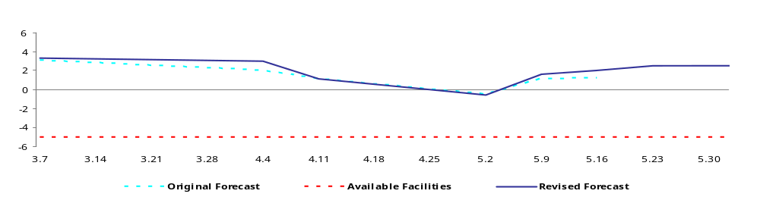
Cash Management
Appendix: Cash report for week ending [ ]
Revised forecast
Dummy Data
Commentary on:
  Forecast headroom
  Forecast level of suppliers due for payment
  Main drivers and assumptions of the cash flow forecast
  Differences between the latest and previous forecasts
  Key risks and opportunities

Slide 31
Our Approach to Working Capital
Monitoring
Monitoring
Investor KPIs
Monitoring of cash flows
and balances
Variance analysis

Slide 32
Monitoring
Project approach Implementation Controlling
The development of an efficient project organisation as well as a standardised Implementation Controlling is the starting point for successful projects
Project Organisation
Implementation controlling and -reporting
Making use of professional Project organisation IT infrastructure in order to optimise processes
Derivation and adoption of Bottom-up-based measurement planning
3
4
Development of a powerful implementation Controlling for the measurement and controlling of the implementation progress
Implementation of a
prompt and robust
reporting with rolling
status reports
2
5
Development of a clearly structured and efficient Project Organisation
Measurement and communication of the success of measures implemented
1
6
Process of the
Implementation
Controlling

Slide 33
Monitoring
Success factors in the implementation process
Throughout the implementation process, all relevant problems are addressed
Coordination and management of the implementation process
Project /
implementation
organisation
Implementation
Controlling
Project structure,
Target definition
and measurement
planning
Professional
software and IT
infrastructure
Reporting/
status reports/
Communication
success of
measures
How is the project organisation managed?
Is the coordination of the implementation of measures centralised?
How are project teams composed?
Is a continuous controlling in place?
How are the effects of a specific measure verified?
Are critical components identified in good time?
How are interdependencies in between sub projects accounted for?
How are projects organised?
Are target values for the individual projects and their time distribution defined clearly?
Are clear responsibilities and the progression of single steps defined?
Are all measures stored in an appropriate, centralised database?
Does the software support the coordination of contents, appointments etc.?
How is the structured registration of projects realised?
Is data security ensured by adequate means?
Is a reporting addressing specific target group in place?
Are status reports promptly available and compiled with minimum effort?
Have “key-charts” for the external communication been defined?

Slide 34
Monitoring
Structuring of the project – general Structure of the project (implementation management)
Our general project structure is divided into 4 separate levels with the level of detail increasing as a lower level is reached
Level of detail
The top level gives an overview of the individual projects, if required of the strategic business units.
Level 1:
Projects
The packages of measures for each operating unit are defined on level 2.
Level 2:
Packages of
measures
The packages of measures are particularised on level 3 by breaking them down into individual measures.
Level 3:
Measures
On the lowest level, the single steps for the individual measure are specified – on this level, there exists a detailed „scorecard“ in order to quantify the effects (responsibilities, start and end date, effect on profits)
Level 4:
Single steps

Slide 35
Monitoring
IT support
The IT support of the Implementation Controlling combines goal-orientation with a high degree of flexibility in the application
Stringent controlling of results and deadlines
Easy application
and installation
Data security is maintained by use of password protected
access
Continuous updating and upgrading
IT backed
KPMG
Implementation
Controlling
Easy coordination
of contents, appointments and responsibilities
Structuring and registration of project contents
Impacts on the financial result and the liquidity are shown
Daily overview of projects by means of automated reports

Slide 36
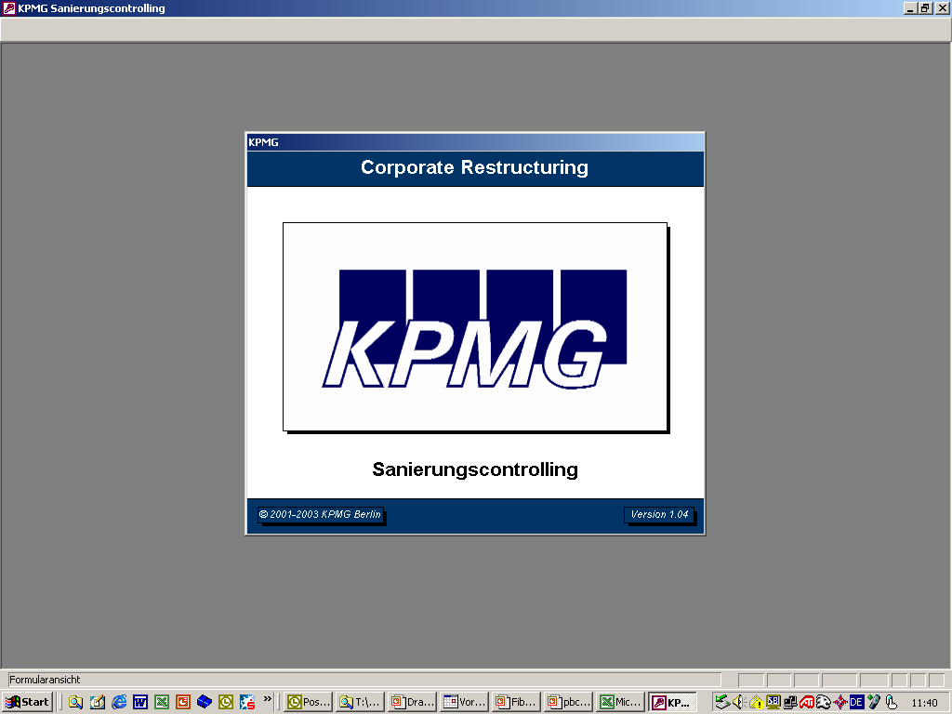
Monitoring
Practical example: Setup of an implementation controlling and reporting
ABCD
Implementation Controlling

Slide 37
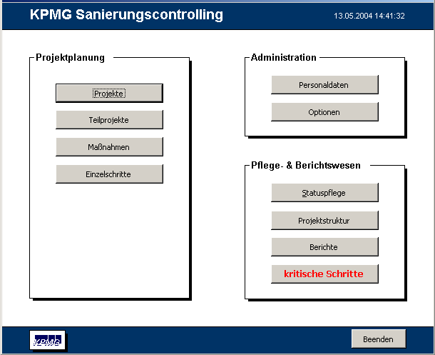
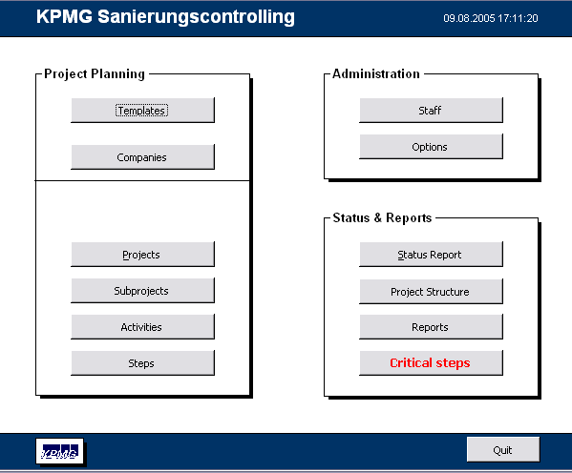
Monitoring
Overview
The implementation of the top-down guidelines given by the control center of Implementation is achieved by a bottom-up project planning
KPMG Implementation Controlling
Database administration and access authorization
Person in charge updates the project
Individual, target group –oriented reports which can be retrieved at any time

Slide 38
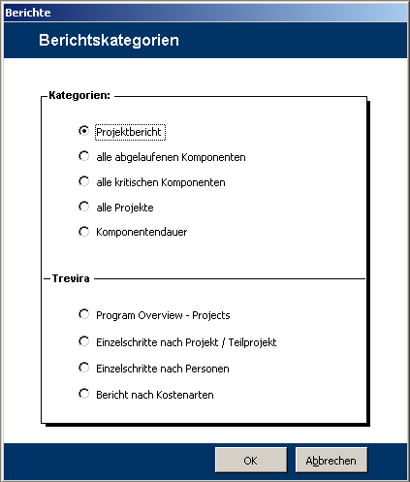
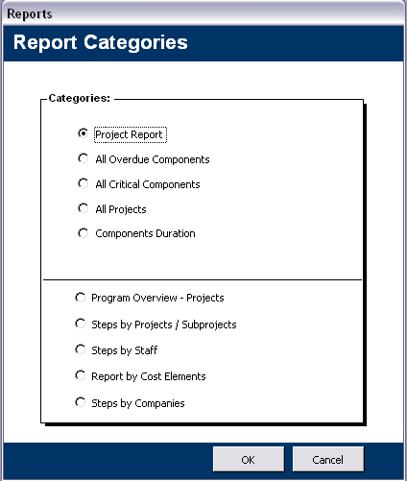
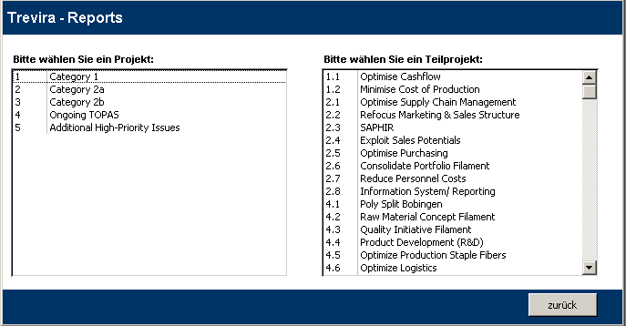
Monitoring
Report Options
Reports can be retrieved for every level
General, standardised reports
Reports
Please choose project:
Please choose sub project:
Individual reports which take into account the specific needs of a particular clients
Client:
Back

Slide 39
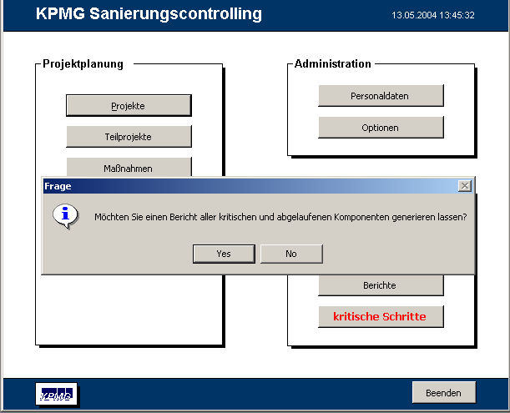
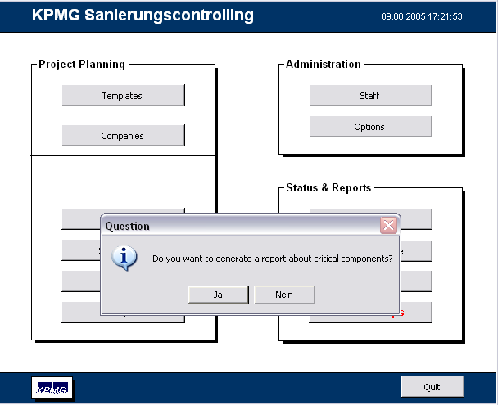
Monitoring
Early – Warning System
KPMG Implementation Controlling
After the start of the program, an automatic display of all critical and expired projects, measures and single steps appears
The display of the above mentioned message can always be retrieved with “critical steps“ button
The criteria for „critical“ can be adapted to the specific conditions of the project

Slide 40
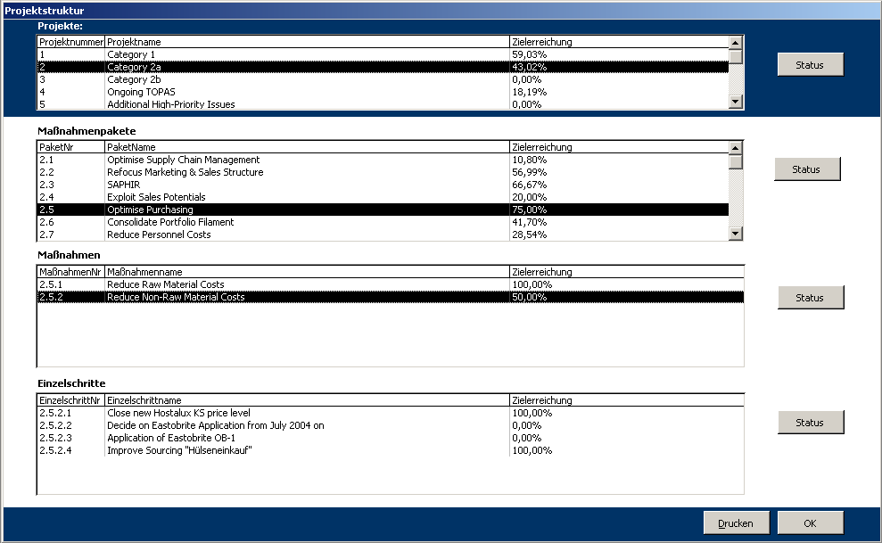
Monitoring
Project Overview
Project structure
Strict hierarchical construction of projects and measures. Also shown are the measures and single steps of the next superior component
Display of component status possible at all levels and any time
Packages of measures
Project #
Name of project
Current achievement
Packages of measures
Package #
Name of package
Current achievement
Measures
Measure #
Name of measure
Current achievement
Steps
Step #
Name of step
Current achievement
Print
OK

Slide 41
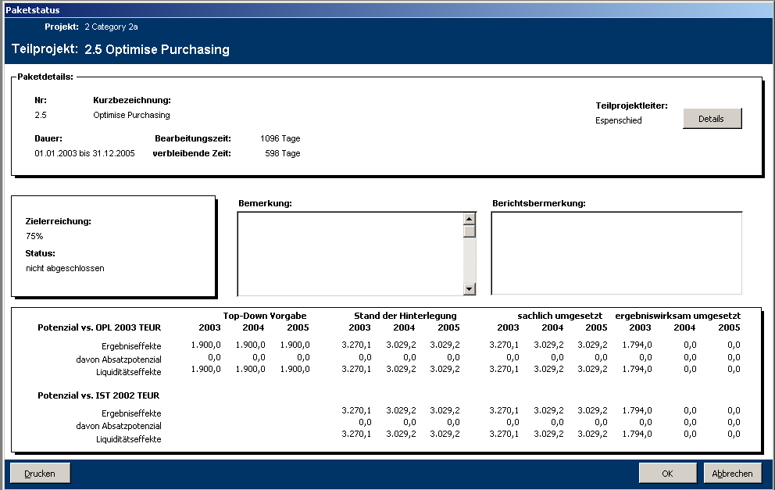
Monitoring
Status Overview
Package status
Project:
Display of current achievement at time of status demand
Sub project:
Package details
Brief description:
Sub project manager:
Duration:
Process time:
days
Budget (Goal) appointed by control center of implementation
-
Remaining time:
days
Comment:
Comment on report:
Current achievement
Extent of effects of all measures deposited by each project team
not finished
Top-Down target
Status of escrow
Factually implemented
Implemented with effect on profit
Effect on profit
Extent of actual terms taken (Reconciliation, P&L, Cash)
Thereof sales potential
Effect on liquidity
Extent of quantified effects of all completed implementations taken by different project teams
Print
OK
Cancel

Slide 42
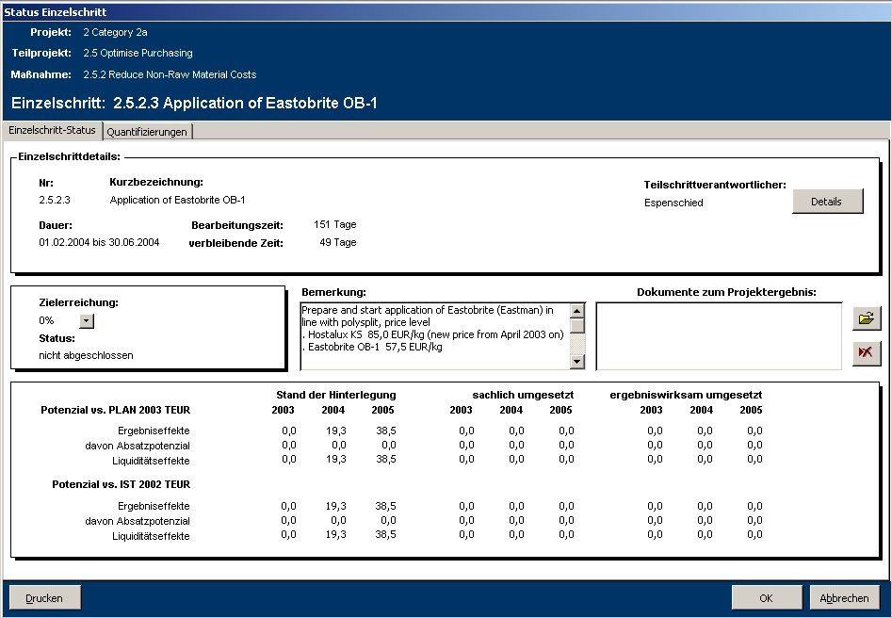
Monitoring
Scorecard
Status of single step
Strict hierarchical classifications up to the level of individual projects
Project:
Sub project:
Measure:
Single step:
Status of single step
Quantification
An individual score card quantifies the effects of the implementations taken
Details of single step
Brief description:
Person in charge for partial stage:
Smith
Duration:
Process time:
days
Remaining time:
days
Comment
Document connected to project outcome
Disposition of deadlines and responsibilities
Current achievement
not finished
Status of escrow
Factually implemented
Implemented with effect on profit
Description and filing of important documents
Effect on profit
Thereof sales potential
Effect on liquidity
Print
OK
Cancel

Slide 43
Appendix I
Case Studies
WORKING CAPITAL MANAGEMENT
2006
ADVISORY

Slide 44
Case Study 1
St. Jacques: Overview
KPMG worked with a Private Equity backed multinational specialist manufacturer to identify working capital improvements and implement a global 13 week rolling cash flow forecast.
The challenge
  Our client had recently acquired a significant competitor and realised that it needed to improve its working capital and cash management to effectively manage the expanded Group and to maximise its profitability.
  Prior to our involvement, there was limited transparency as to the actual liquidity of the Group and the importance of this was increased as the final purchase price was based on certain post acquisition targets.
  In addition, the combined Group had several thousand product lines which absorbed a substantial working capital and management resources, which management wanted assistance to rationalise.
  KPMG was asked to implement a cash management system within the Group and to identify and target working capital improvements.
Approach
By working with management around the Group we identified significant areas of surplus working capital and devised the steps the Group needed to go through to realise these opportunities. This process was complicated by key resources being diverted to complete the acquisition.
KPMG carried out a rapid review of the cash flow forecasting systems within the enlarged Group and once the limitations of the incumbent system were realised, we set about implementing an new system to address current and likely future requirements.
Our process included management workshops to increase the acceptance of the projects and ensure their successful rollout across the Group.
Results
Identified significant working capital and other cost savings within the Group and educated management on the best ways towards realising these in a short space of time.
Implemented a global 13 week rolling cash flow forecast updated by each entity on a weekly basis, ownership of which was successfully transferred to the group.
Determined the liquidity and key data of the acquired company at year end which was used to determine the accurate acquisition price for the company.
Turnover (m€)
  90
Nature of business
  Specialist manufacturer supplying to the biotechnology industry

Slide 45
Case Study 1
St. Jacques: Time schedule and results
Our work was limited to 13 weeks, and we planned our work to ensure that we delivered the client’s requirements within this relatively tight timescale
Following the initial identification we established which items management wanted to progress and worked with them to create suitable implementation plans.
Our review looked at all areas of the Group and quantified the improvement that could be achieved by specific changes. Amongst other things, we challenged the level of management information, the IT integration and the speed of communication. These helped identify key blocks within current processes which could then be addressed.
Following our identification and process work, the tasks were undertaken by management, who worked towards full implementation.
We continued to be available to management after our role had finished in order to support them further as and when required.
Nov
Dec
Jan
Feb
In a short space of time the client achieved a clear idea of opportunities within Group and action plans to work towards realising them
The Group now has a fully functional global cash flow forecasting tool
Identification
Development of opportunities
Assign targets
Implementation
Implemented cash forecasting process
Ongoing cash flow analysis and forecasting
Developed Cash Culture within the company
We coached staff to provide detailed, timely cash flow forecasts of their corresponding areas.
This included a full unwind of the ledgers and ensuring that all items were effectively included.
KPMG joined the different weekly cash flow forecasts together. Thereby, we
The 13 week cash flow was developed and rolled out across the Group. By ensuring a robust methodology was used from the beginning, meant that the process could be tailored to the requirements of the client.
We set targets to focus attention towards delivery. Weekly updates were provided to management so that they could quantify the progress being made.
Increased focus on cash impact of activities led to cash becoming a key point in the management agenda.
reviewed the detailed forecasts
coached staff to ensure they could competently deal with the tasks

Slide 46
Case Study 2
Fibre: Overview
KPMG assisted hands-on in the fields of working capital and cash management
The challenge
  Following a covenant breach on its loan facility, a chemical manufacturer with several production facilities across European countries appointed KPMG to provide hands on working capital and cash management, establish a liquidity reporting system and design an operational improvement plan
  Lack of robust liquidity forecast and major improvements in working capital for decision making
  No experience in preparing a detailed cashflow forecast or improving working capital nor capacities to handle such a project
Approach
  Providing hands on assistance in producing a rolling liquidity forecast and designing a detailed procedure for the cash management including top management meetings on a weekly basis
  Achieved an agreement with the major shareholder to provide a fifty percent credit guarantee on basis of a liquidity report
  Executed several quick wins optimizing debtor and creditor management and introduced a variable payment system
  Prepared an improvement plan which included a comprehensive analysis to assess the causes of the crisis and suggest restructuring measures and follow-ups for working-capital and cash improvement
Results
  Group achieved improvements in working capital management: Cash savings 31 m€ (10% of turnover)
  Through high transparency for all parties involved it was possible to draw on the company’s previously suspended working capital facility
  Following the presentation of the plan a new financing agreement was signed
  Due to the stabilization and restructurings the company was successfully being sold
  KPMG continues to be involved in the implementation of the improvement plan by assisting in project organization and control, monthly status reporting and further advice in cash / working capital management and cash reporting
Turnover (m€)
  320
Nature of business
  Fibre producer

Slide 47
Case Study 2
Fibre: Time schedule and savings
6.1 m€ cash benefit (Payables and Receivables)
7.5 m€ cash benefit (Receivables, order process) without financial restructuring of loans
Benefit tracking established early on and directly linked to staff incentives
Embedded longer term sustainable initiatives:
  Optimisation order control
  Sales initiatives (structure, centralisation, prising)
  Product-Portfolio-Reduction
  Cost reduction initiatives
17.6 m€ cash benefit (financial supply chain, inventory)
Feb | Mar | Apr | May | Jun | Jul | Aug | Sep | Oct | Nov | Dec
Robust 10 week cash forecasting |  |  |  |  |  |  |  |  |  |  | Group achieved cash improve-ments of 31.2 m€ and additional projected cash savings of 18.4m€ (full year net effect)
Identifica-tion of urgent w/c initiatives |  | Top-down analysis and bottom up verification of cash generation initiatives (short and long term) |  |  | Project controlling & monitoring (status of the initiatives) Additional analysis by request
 | Implemen-tation „Quick wins“ | Implementation and monitoring of urgent cash-initiatives (category 1) |  |  | Implementation of W/C-initiatives (category 2a / 2b)
Weekly Cash-Desk-Meetings to focus Management and to establish a “Cash culture”
Rolling Forecast (Monitoring of initiatives & cash forecasts)
We coached the relevant staff (finance, sales, purchase etc) so that that Group is able to provide detailed, timely cash flow forecasts
  Anchoring the 10 week forecast to an opening balance sheet position
  Profiling receivable collections (SAP-Interface for historical payment behaviour)
  Forecasting key supplier payments
  Unwinding key accrual accounts and other payables
Implemented monitoring process to help management better understand variances and improve forecasting procedures
Short term cash flow forecast with ongoing review role embedded within ‘business as usual’
Change in the culture of the business developed with a focus on the cash impact of activities leading to cash becoming a key issue in the overall management agenda
Historical W/C-Performance
Benchmarking
A-B-C analysis
Work shops
Focus on implementing sustainable and tactical initiatives

Slide 48
Appendix II
Credentials
WORKING CAPITAL MANAGEMENT
August 2005
ADVISORY

Slide 49
Credentials
How we have helped Private Equity Houses in the past
We have assisted Private Equity Houses in all aspects of cash and working capital
Project Name | Turnover (m€) | What did we do? | What was the outcome? | Identified savings (m€)
Gaza | 130 | Identified the immediate short term funding requirement of the acquisition. Identified opportunities to generate cash and assess the adequacy of the cash controls. | The cash management work undertaken proved to be very important in the decision for the deal to go ahead. | 16
Mary | 150 | The company had identified the need for additional funds and required professional support in negotiating with the banks. | We assisted in the process of raising the required funding and optimised short term cash flows in order to avoid any short term cash issues. | confidential
Simpson | 50 | The company was under pressure to work up a restructuring plan or face the prospect of insolvency. They engaged us to create a viable plan for the banks. | The banks were impressed with our plan and relied on our work. This meant they didn’t seek insolvency and didn’t appoint a different advisor. | 5
Paint | 35 | The company was at the peak of its working capital and had no headroom. Funding requests of 3m£ to lenders were rejected. We implemented short term cash flow forecasting to identify the size of the problem and then implemented initiatives to generate cash. | Generated additional headroom and allowed a measured refinancing to occur. | 5
Kestrel | 200 | The company was seeking refinancing from its lenders but was experiencing liquidity issues. On behalf of the stakeholders we reviewed the short term cash flow forecast and identified the key issues affecting short term cash flow performance. Stakeholders and management were provided with an action plan to address the issues. | The company was refinanced and no short term funding was required. | 25
Jeff | 1,000 | The company was undertaking a due diligence exercise and needed comfort over future cash flows as part of its negotiations. | We assisted the company in its focused review of the cash flow forecast. | n/a
Louise | 350 | Provided cash management advice to preserve and generate cash prior to the divestment of the business. The sale was based on profitability and not cash. | The company was successfully sold and the PE house obtained a maximised return on their investment. | n/a

Slide 50
Credentials
Recent European cases involving Working Capital improvement
Project Name | Sector | Main issues | Areas of KPMG work
Turenne | Global ICT service provider | The group with an annual turnover of 3,500 m€ had a limited cash focus, resulting in excess cash being held in major markets globally while central borrowings were needlessly high Group‘s treasury function did not make best use of liquidity | KPMG initially developed weekly reporting of cash balances which encouraged regular repatriating allowed for a reduction of the “operating cash” level by 70 m€ and reduced borrowings A team of treasury specialists reviewed management’s plans and made recommendations on a suitable cash sweeping and pooling structure After the immediate measures a detailed working capital action plan was developed and implemented by the management
Phillip | Retail | The multinational company with a turnover over 6,500m€ was underperforming in several distribution channels Cost reductions were insufficient to cover necessary accruals High uncertainty about management’s restructuring plan | Review of the restructuring plan Strategy development based on a comprehensive analysis of the financial position and the management team Transformation of the strategy into detailed actions Strong focus on cashflow improvements based on working capital optimization Stakeholder trust was restored
Wildcard | Printing and Technology | Printing group with annual turnover above 1,000 m€ Subsidiary operating in chip-set and system solution markets was in crisis due to downturn in telecoms markets. Chip card business was making losses and failing to adapt the cost structure to market conditions Separation of chip-set and system solutions was being considered | The robustness of the company’s forecast was tested KPMG carried out a comprehensive analysis of the business and developed a detailed cost reduction program including cost reduction measures in all operational areas A scenario for a potential break up of the company was established

